Slide 1
Genetic Algorithms for Evolving Computer Shogi
Ryan Cain

Slide 2
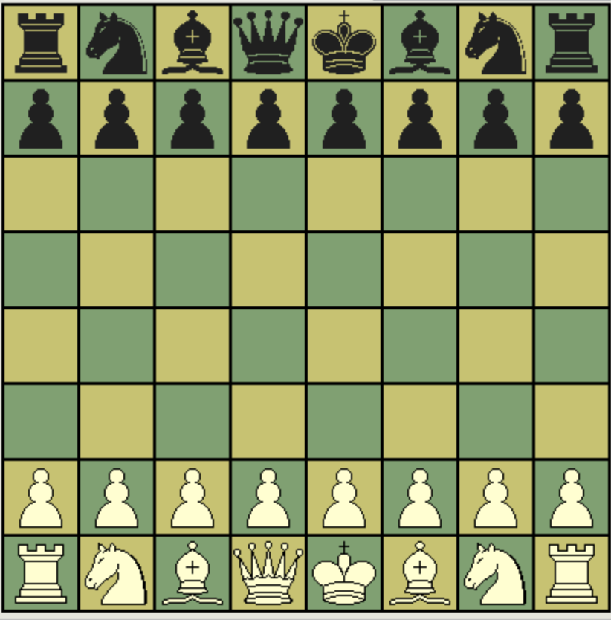
What the hell is Chess?
8
8
6 Unique Pieces

Slide 3
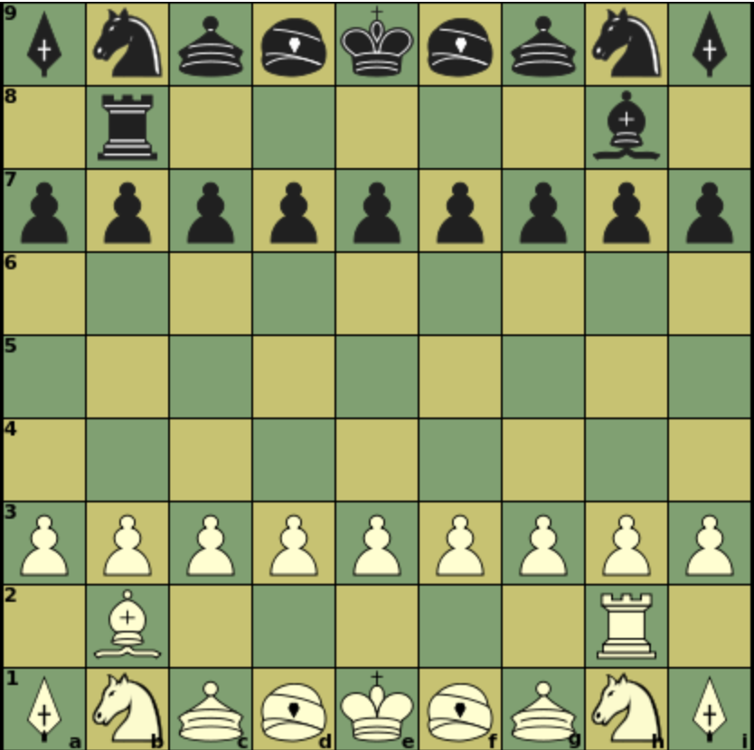
What the hell is Shogi?
9
9
8 Unique Pieces

Slide 4

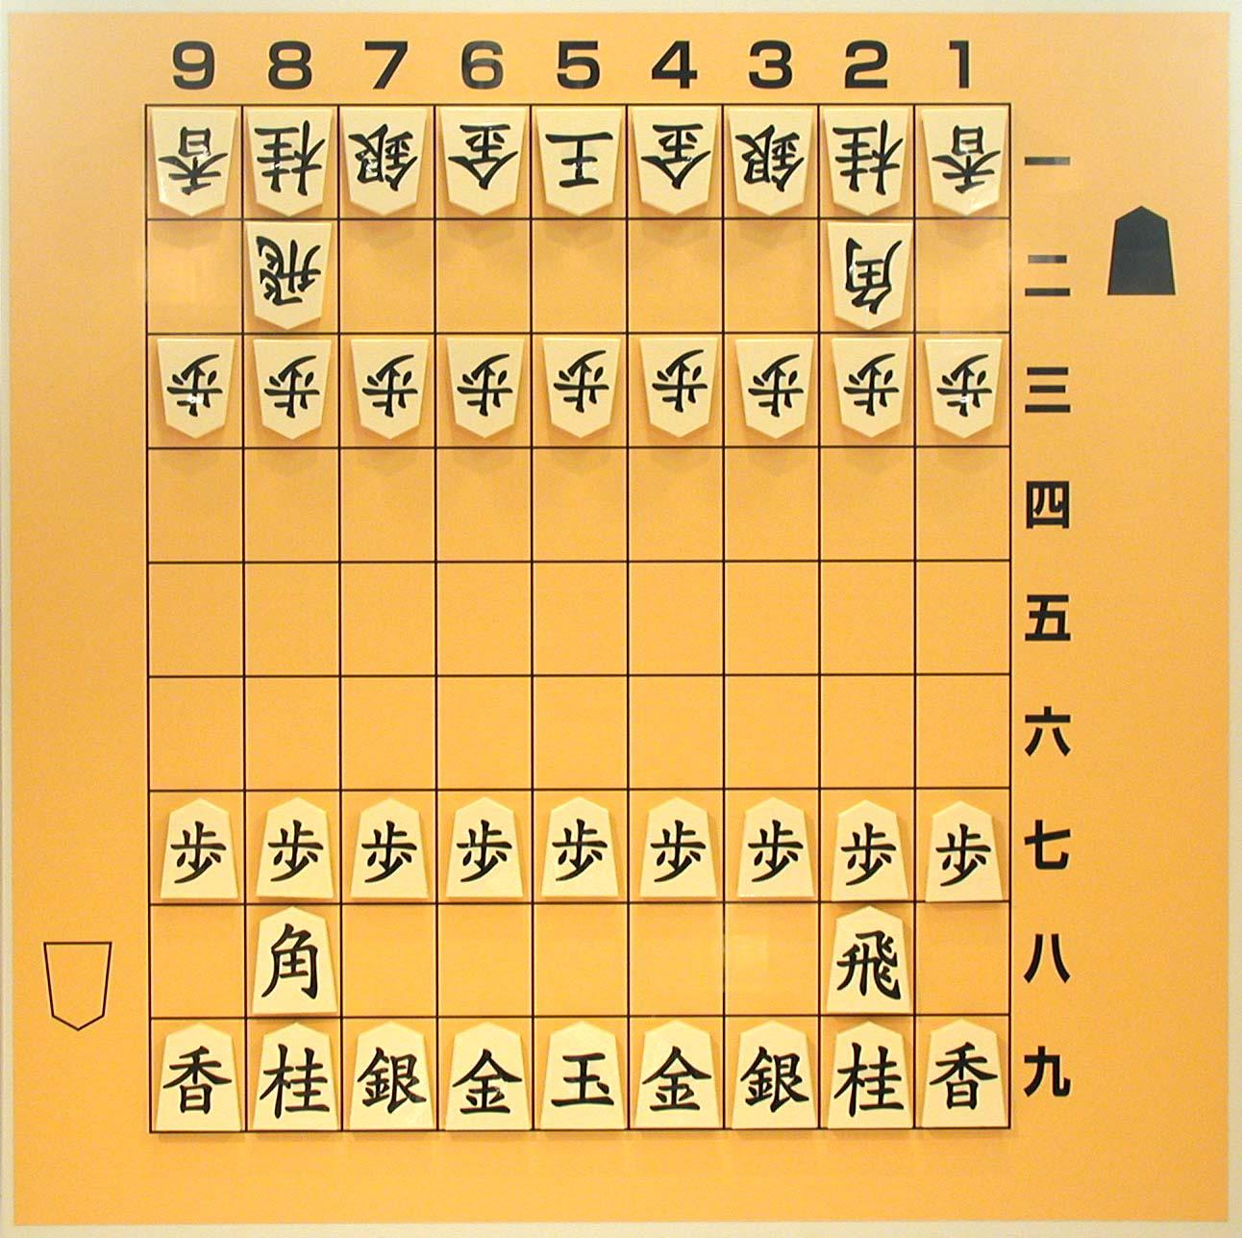
Traditional Board
“White”
“Black”

Slide 5
Harder to Read, Messier Chess?!?
Yes, and . . .

Slide 6
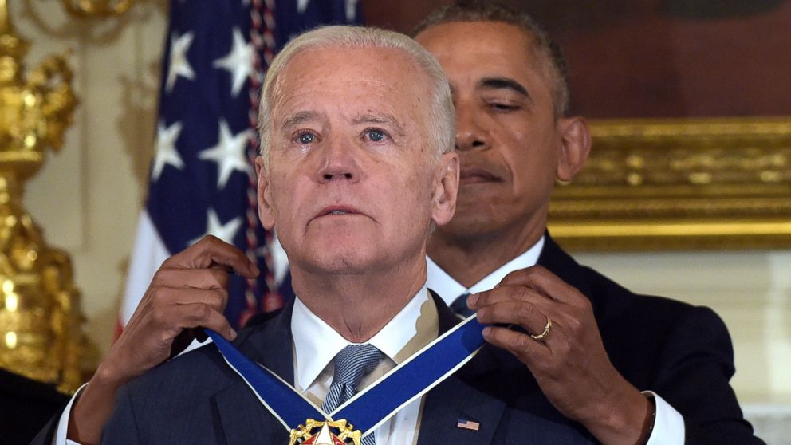
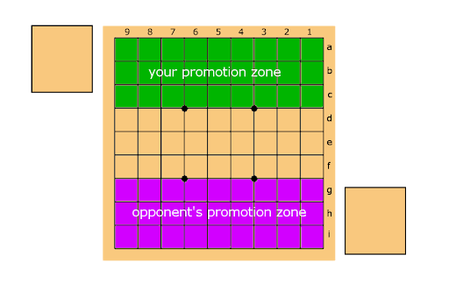
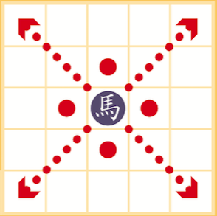
Harder to Read, Messier Chess?!?
Yes, and . . .
Promotions

Slide 7
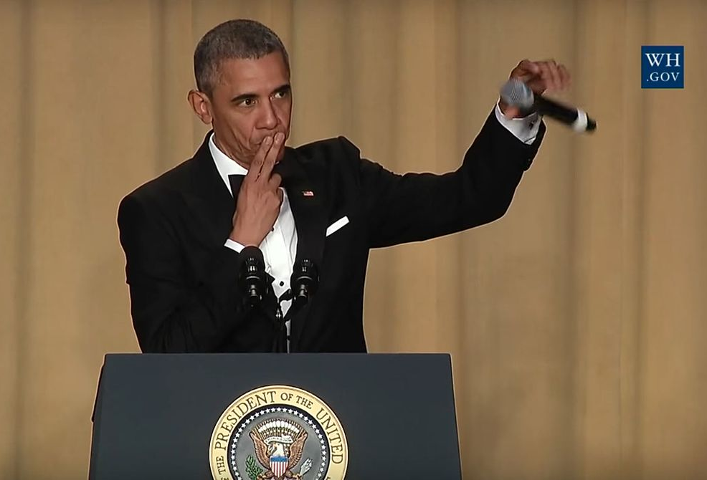
Harder to Read, Messier Chess?!?
Yes, and . . .
Drops

Slide 8
More Moves Move Problems
How can computers learn to play such big games?
10⁸²
Atoms in observable universe
10¹²³
Possible chess games
10²²⁶
Possible shogi games
Notes:
10^71 possible legal moves in shogi, so for any given position to find the best next move you would have to play out all possibilities to the end of the game and see which next position gives you more wins. If we searched each position one by one by today’s current speeds it would take almost the time to search everything as it will for the universe to die of heat death.

Slide 9



A few options
Tabula Rasa - learn from scratch

Slide 10

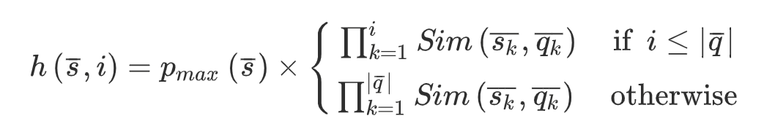
A few options
Bake in some existing information
Heuristic Evaluation
Notes:
We can give the computer some information about the state of the game it is looking at and perform some calculations

Slide 11
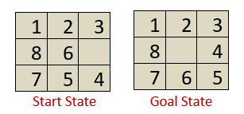
Heuristics in a Simple Game
Start State
Goal State

Slide 12
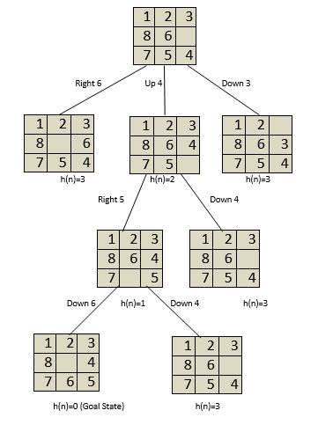
Start State
Heuristics in a Simple Game
Right 6
Down 3
Up 4
H(pos) = Number of tiles out of position
H(p₁) = 3
H(p₂) = 2
H(p₃) = 3
Notes:
We can give the computer some information about the state of the game it is looking at and perform some calculations

Slide 13
Start State
Heuristics in a Simple Game
Right 6
Down 3
Up 4
H(pos) = Number of tiles out of position
Right 5
Down 4
H(p₁) = 1
H(p₂) = 3
Down 6
Down 4
H(p₁) = 0
Goal!
H(p₂) = 3
Notes:
We can give the computer some information about the state of the game it is looking at and perform some calculations

Slide 14
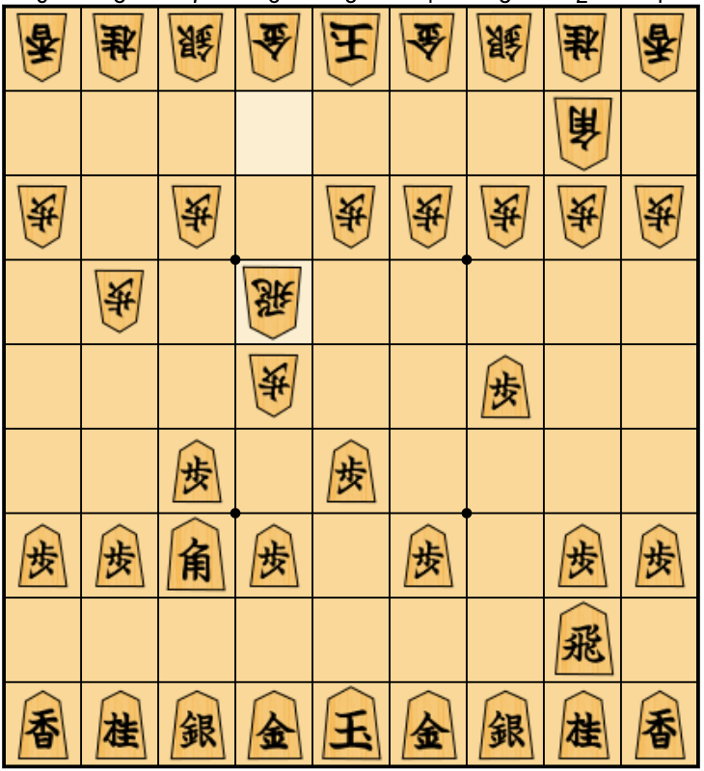
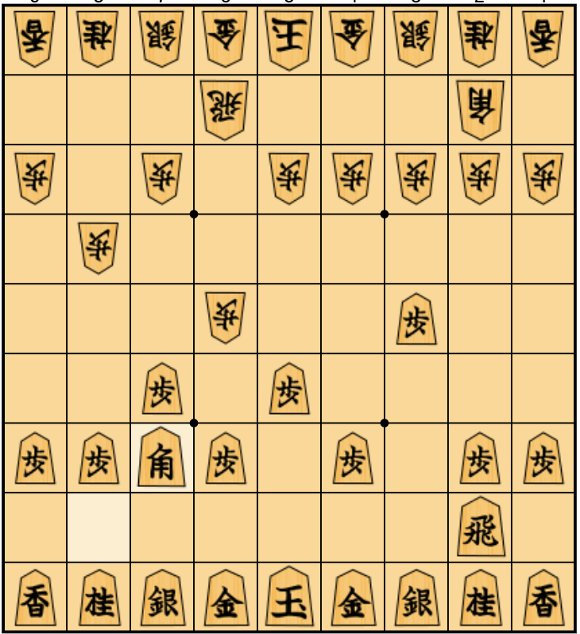
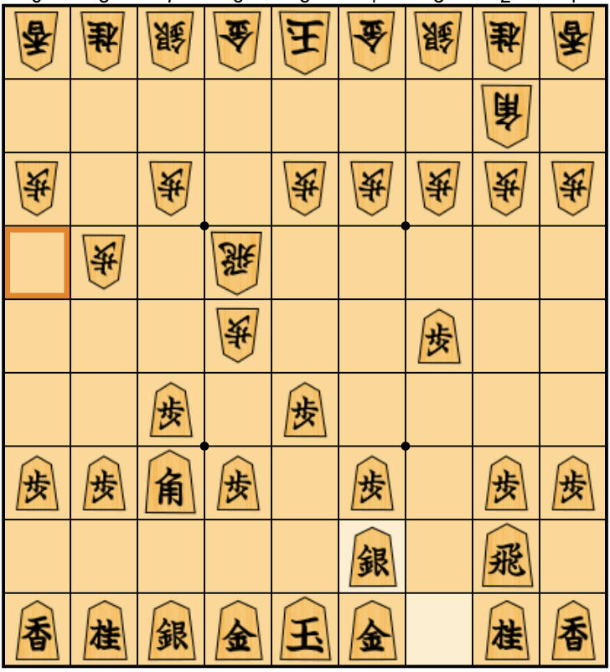
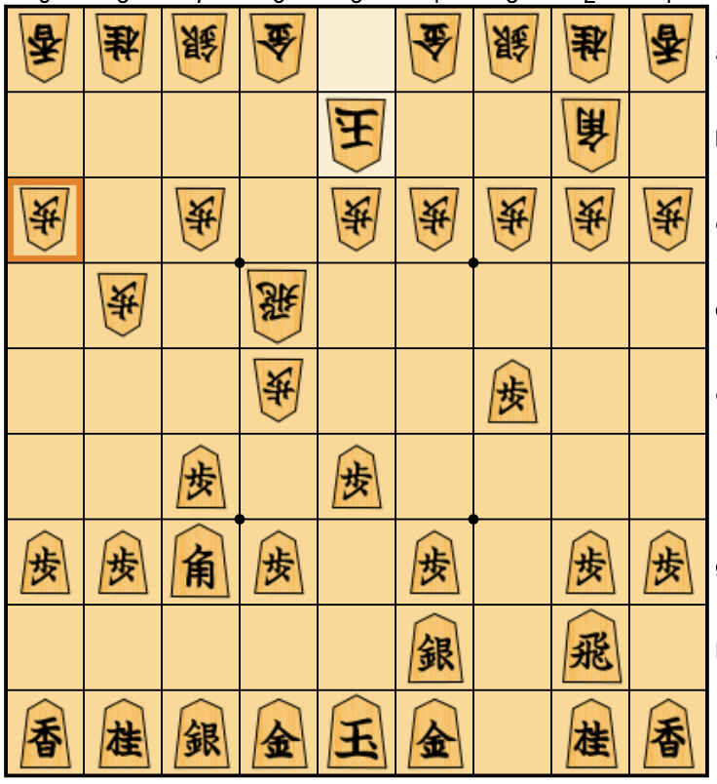
Heuristics Search in Chess
Same, but two perspectives
?
MAX(
)
39
38
6
MIN(
)
10
39
-2
-77
38
111
6
-98
-34
Notes:
We do not have to search all the way to the end, we can stop at any point, look at any position through the lens of our heuristic function and get a rough estimate of how good it is. That way we can search through positions in a given time frame.

Slide 15
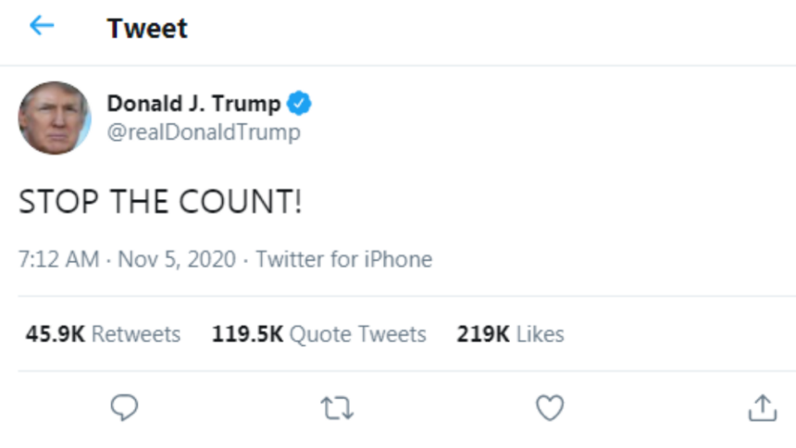
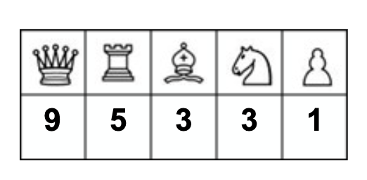
What heuristic do we use?
Count the pieces
… Just once
Notes:
We do not have to search all the way to the end, we can stop at any point, look at any position through the lens of our heuristic function and get a rough estimate of how good it is.

Slide 16
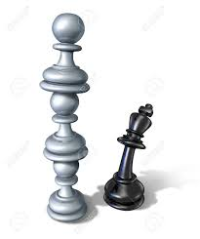
What heuristic do we use?
2. Add more features
King safety
Pieces available to drop
Promoted pieces
Freedom of movement
Bishop on king file
Stacked pawn penalty
etc
Notes:
We do not have to search all the way to the end, we can stop at any point, look at any position through the lens of our heuristic function and get a rough estimate of how good it is.

Slide 17
What heuristic do we use?
Others
Count Features
King safety
Pieces available to drop
Promotions
Freedom of movement
Stacked Pawns
Bishop on king file
In-camp freedom
Out-camp attacking
Castle formation
. . .
H(pos) =
1
1
2
2
7

Slide 18
What heuristic do we use?
Others
Count Features
King safety
Pieces available to drop
Promotions
Freedom of movement
Stacked Pawns
Bishop on king file
In-camp freedom
Out-camp attacking
Castle formation
. . .
H(pos) =
How important is each feature?
1
1
2
2
7
Notes:
We do not have to search all the way to the end, we can stop at any point, look at any position through the lens of our heuristic function and get a rough estimate of how good it is.
These are the “weights” associated with each of the features. So for example, the ‘weight’ of a queen would be very high since it is a valuable piece where as the weight of a pawn is very low. Features that rate king safety should also have a high weight compared to other features.
The sum of these weights and features

Slide 19
What heuristic do we use?
Others
Count Features
King safety
Pieces available to drop
Promotions
Freedom of movement
Stacked Pawns
Bishop on king file
In-camp freedom
Out-camp attacking
Castle formation
. . .
H(pos) =
<,w₁, w₂ ,w₃, w₄, w₅ . . .>
1
1
2
2
7
Notes:
We do not have to search all the way to the end, we can stop at any point, look at any position through the lens of our heuristic function and get a rough estimate of how good it is.
These are the “weights” associated with each of the features. So for example, the ‘weight’ of a queen would be very high since it is a valuable piece where as the weight of a pawn is very low. Features that rate king safety should also have a high weight compared to other features.
The sum of these weights and features

Slide 20
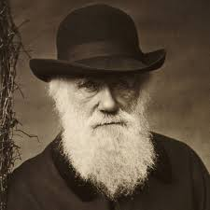

But what about the weights?
Can we let nature decide?
Genetic algorithms and natural selection

Slide 21
An organism as a binary chromosome
An ‘organism’ is a unique solution
→ a set of weights for our heuristic
0010 1010 1011 1000 1111 0101
2
10
11
8
15
5
King safety
Gene
Notes:
Unique set of weights for our heuristic function. So to get our heuristic number we would do 2 * pawn count, 10 times knight count, 11 times rook count…. Etc.
Chromosome
Gene
Population of individuals

Slide 22
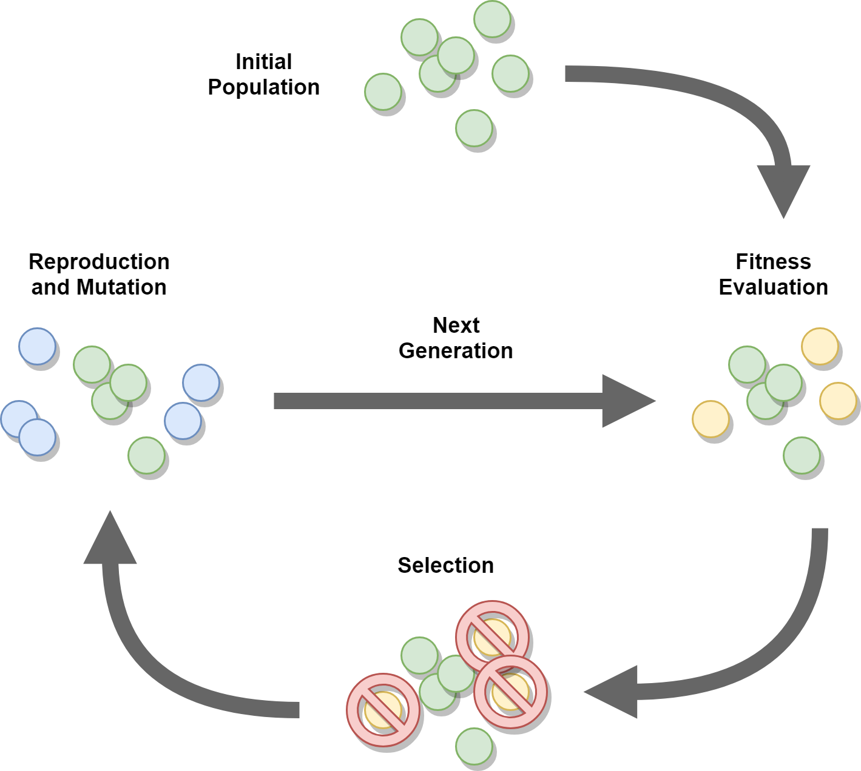
Simulating natural selection
01
Selection
02
Crossover
03
Mutation
Notes:
3 key stages exist in almost every genetic algorithm, though there are some variants:
Variants include different ratios of crossovers to mutations, not allowing a crossover agent to be mutated, not allowing a mutated agent to be crossed…. etc.

Slide 23

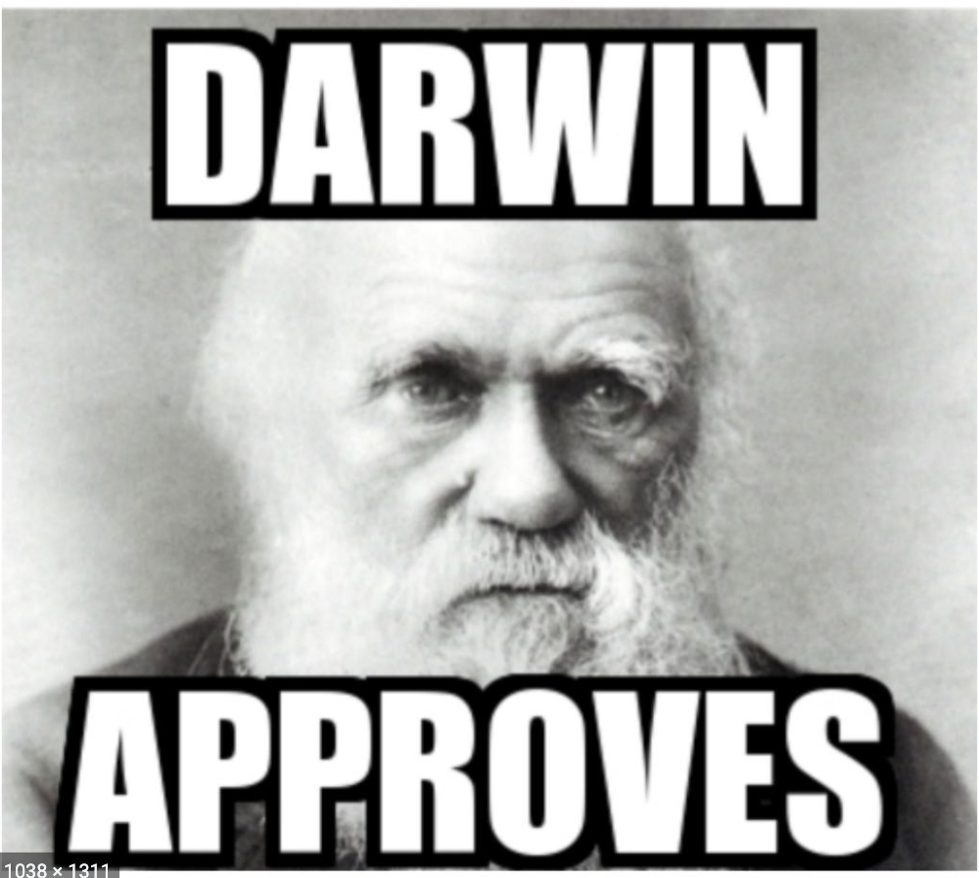
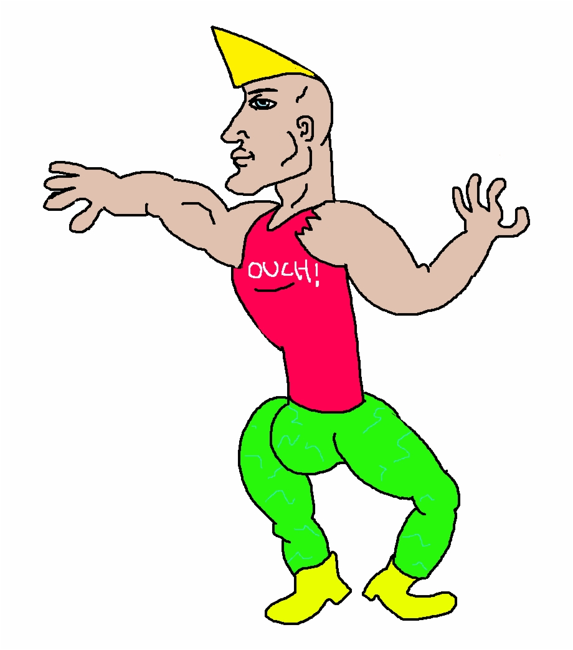
Simulating natural selection
01
Selection
02
Crossover
03
Mutation
Notes:
Fitness proportional selection tournament -> what its fitness for our single chromosome organsim? What is the analogy to how strong it is to survive?
Eletism
Grandmas
Talk about FITNESS and how it is calculated with grandmaster games and elitism here.

Slide 24


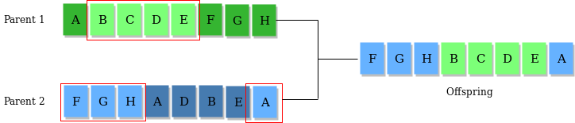

Simulating natural selection
Parent 1
Parent 2
01
Selection
02
Crossover
03
Mutation
Enhanced Offspring
Notes:
Represents mating between individuals, after two individuals are selected with the selection operator
Crossover sites usually chosen randomly
Genes at the crossover sites are exchanged creating a completely new offspring

Slide 25
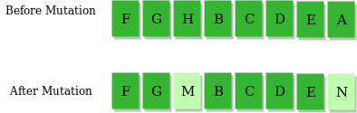


Simulating natural selection
Before Mutation
01
Selection
02
Crossover
After Mutation
03
Mutation
Notes:
Insert random genes in offspring to maintain the diversity in the population
Also avoids premature convergence
Serves as a form of “exploration” like with UTC
Give us more potential access to the search space

Slide 26
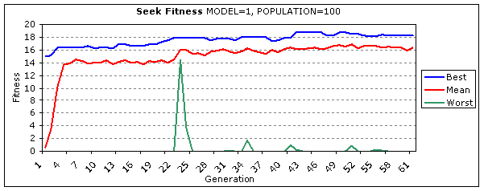
Simulating natural selection
03
Rinse and repeat!
Notes:
200 generations, 100 individuals. End up predicting about 30 percent of grandmaster games. Combined with the min max search approach described above I get decent results!

